Slide 1
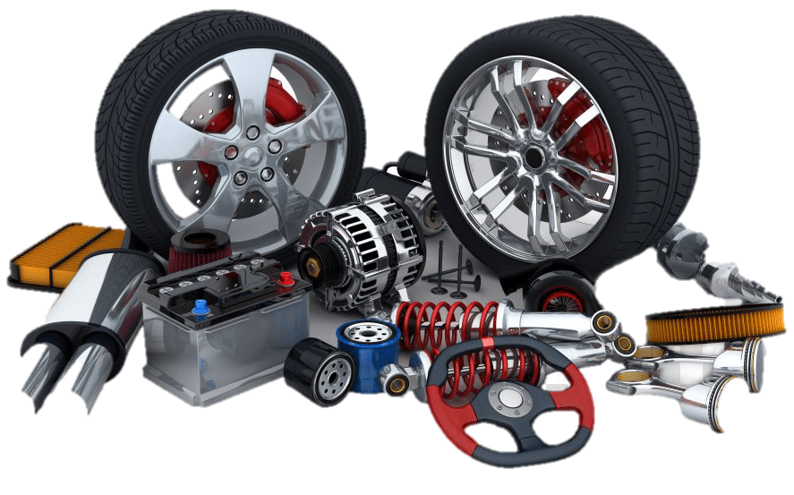


Inventory Management
2021 - 2022
Developed By :
Nityanand Jha [Seat No. –Y 209]
Alpesh Mishra [Seat No. – Y 047]
Saurabh Updhaya [Seat No. – Y 146]
Guide By :
Chirag C. Patel
College :
S.D.H.G College of BCA & IT

Slide 2

S.D.H.G College of BCA & IT
214, Ranchhod Nagar, Opp. Swami Narayan Temple, Udhna - Navsari Main Rd, Udhna, Surat, Gujarat 394210, India
www.udhnacitizen.org | uaccait@gmail.com | 0261-2277739

Slide 3
🎁Points
👉 Introduction.
👉 Operational Environment.
👉 Project Profile.
👉 Aim of project.
👉 Pros / Scope of Project.
👉 Requirements.
👉 Model of Project.
👉 Data Flow Diagram.
👉 Database Designing.
👉 Interface Designing.
👉 References.
👉 Thank You

Slide 4
INTRODUCTION
Online shopping is a form of electronic commerce which allows consumers to directly buy goods or services from a seller over the Internet using a web browser. Consumers find a product of interest by visiting the website of the retailer directly or by searching among alternative vendors using a shopping search engine, which displays the same product's availability and pricing at different e-retailers.
We are sale “Automobile Parts / Spare Parts” on E-commerce Platform.
Online stores usually enable shoppers to use "search" features to find specific models, brands or items.

Slide 5
Benefits of Existing System
1. Faster Buying Process.
2. Scalability.
3. Customer Data Insights.
4. Targeted Marketing.
5. Increased Profit Margin.
6. Wider Customer Base.
7. Reviews & Ratings.
8. Product Catalogue.
9. Low costs.

Slide 6
Limitation of Existing System
1. Frauds in online shopping.
2. Delay in the delivery.
3. You can't touch the product.
4. You cannot bargain.
5. Hidden costs and shipping charges.
6. Lack of interaction.
7. Returning the product.
8. Low Level of Security.
9. Time Consuming.

Slide 7



Project Profile
Project Title | : Inventory Management
Project Category | : E-Commerce
Project Guide | : Chirag C. Patel
Frontend Technology | : Sublime Text 3.2.2
Backend Technology | : MySQL( phpmyadmin )
Framework | : Larval Framework
Team Members | : Nityanand Jha (Y-209), Alpesh Mishra (Y-047), Saurabh Updhay (Y-146)

Slide 8
Aim of System
1. product advertising:
The main purpose of a business site is to promote company’s products, services or events on the Internet. There are two main aspects to discuss. First, there are websites that don’t directly sell anything but their objective is to create “buzz” or awareness.
2. Selling a product online:
This is basically the main reason behind the existence of any business website. Selling products and services is the most common objective.

Slide 9
Aim of System
4. Providing corporate information:
Almost all big company websites have a section featuring pertinent corporate information for potential investors. The information in this section usually refers to: corporate background, company officials, different articles and editorials written about the company along with related images as well as contact information and links to personal profiles of company’s representatives charged with management, customer care, advertising, etc…
5. Establishing brand awareness and identity:
Establishing brand awareness or company identity is an ongoing process with the purpose of branding products with memorable names, eye-catching logos and maybe a slogan. In order to establish brand identity, your website must address these elements in a unitary manner. The product logo must reflect the design of your website in terms of graphics, colours, font types and sizes

Slide 10
Scope of System
Admin Side:-
Maintain Product details
Unlimited Product Upload
Maintain Customer details
Flexibility to Manage Sales
Maintain Order
Easy Customer Management

Slide 11
Scope of System
Client Side:-
User can login
User can book Product
User can Register
User Can Check Order Details
User Can Manage Profile
User Can Buy Product
User Can Check Out
User can check about us page
User can check contact us page
Logout

Slide 12
Operational Environment
Hardware
Software
RAM : 6 GB
Hard disk : 512 GB (SSD)
Processor : 13 Processor
Operating System : Microsoft Windows 10
Compatible Browser : Mozilla Firefox, Google Chrome, etc.
Front End : Microsoft Visual Studio
Back End : MySQL(phpmysqladmin)
Server : Apache, Wamp Server Version – 2.4.46
Tools Used : HTML, CSS, JavaScript, Ajax , Bootstrap, PHP, JQuery, Laravel Framework
Framework : Laravel , version – 8.79.0
Composer , version – 2.2.4

Slide 13
Modules
Admin
Users

Slide 14
Requirement Analysis
Requirement analysis can be said to identify investigation, documenting and analysing requirements of the system. The first investigation step of the need of a system is a major activity of problem analysis.
This is the role of a system analyst to determine the actual requirement of a system. Sometimes, system analyst may make mistake in discovering the requirements and in trying to analyse a problem.
As a result, they may come up with the wrong solution in designing and implementation of a solution.
And the solution will not be able to solve the real problem and even cause a new problem in later system analysis process. Therefore, this paper looks at one of the effective methods (fact-finding) for system analyst to help them in gathering information.

Slide 15
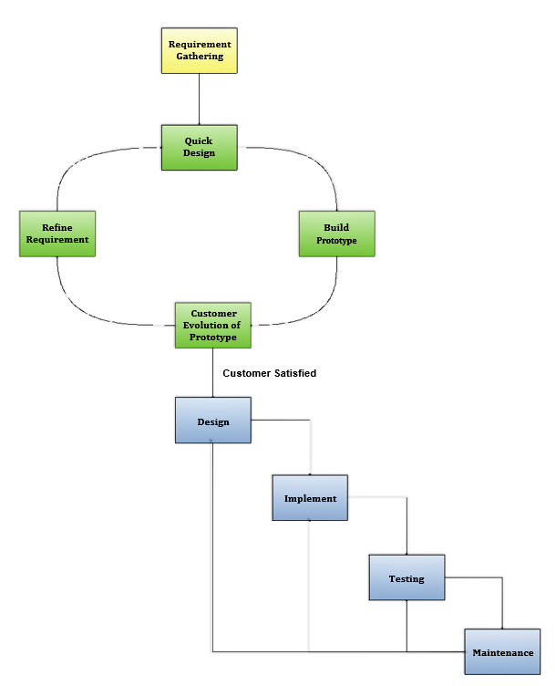
Prototype Model

Slide 16
Prototype Model
Advantages of Prototype model:
This model is flexible in design.
It is easy to detect errors.
We can find missing functionality easily.
It can be reused by the developer for more complicated projects in the future.
It ensures a greater level of customer satisfaction and comfort.
It is ideal for online system.
It helps developers and users both understand the system better.
It can actively involve users in the development phase.

Slide 17
Prototype Model
Disadvantages of Prototype model:
This model is costly.
There may be too much variation in requirements.
Customers sometimes demand the actual product to be delivered soon after seeing an early prototype.
There may be sub-optimal solutions because of developers in a hurry to build prototypes.
Customers may not be satisfied or interested in the product after seeing the initial prototype.
There is certainty in determining the number of iterations.
There may be incomplete or inadequate problem analysis.
There may increase the complexity of the system.

Slide 18
Diagrams
Flow Chart
Data Flow Diagram

Slide 19
Flow Chart
A pictorial representation of an algorithm is called a „Flowchart‟. In flowchart, the steps in the algorithm are represented in the form of different shapes of boxes and the logical flow is indicated by interconnecting arrows.
The boxes are used to represent different operations and the arrows are used to represent the sequence of these operations. Since this is a visual way of algorithm representation, it helps the programmer/tester in understanding the logic of the program.

Slide 20
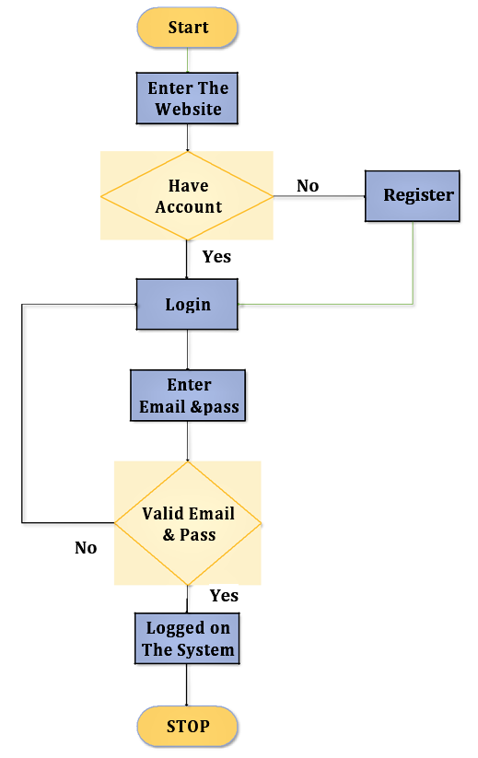
Flow Chart
Flow Chart for Login Process

Slide 21
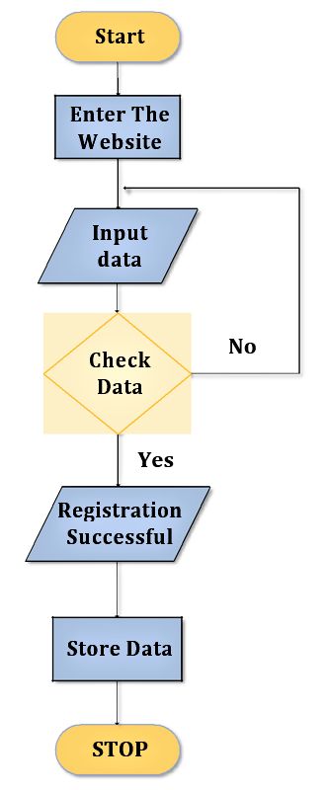
Flow Chart
Flowchart for Registration Process

Slide 22
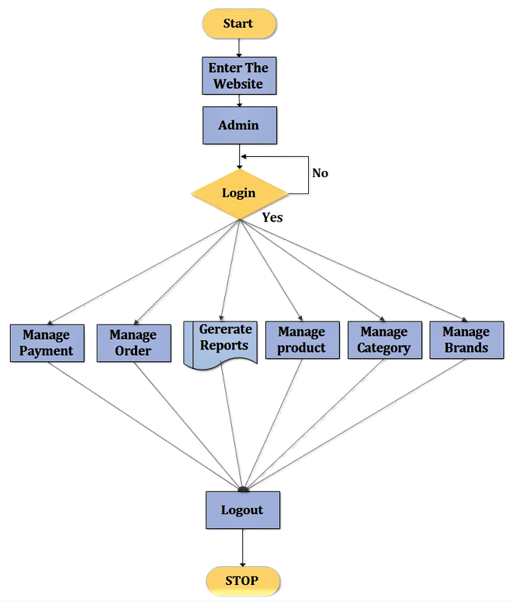
Flow Chart
Flowchart for Admin Side
Process

Slide 23
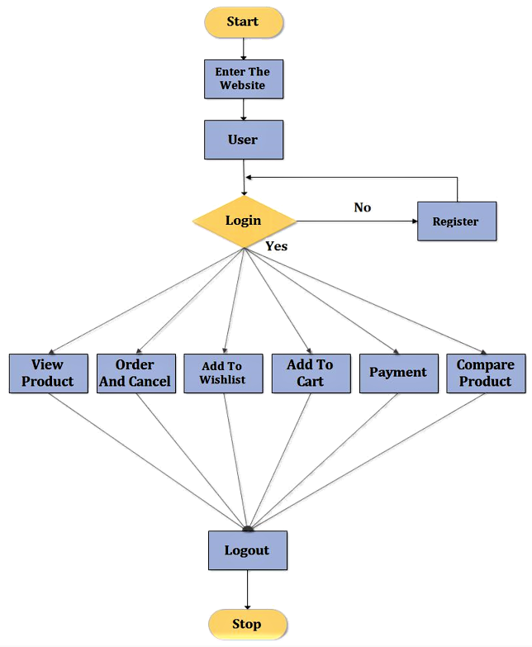
Flow Chart
Flowchart for User Side
Process

Slide 24
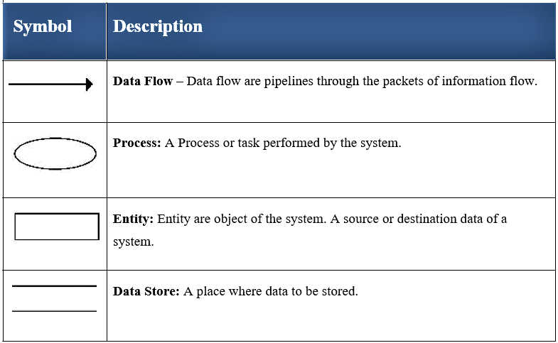
Data Flow Diagram (DFD)
A data flow diagram is a graphical view of how data is processed in a system in terms of input and output.
The Data flow diagram (DFD) contains some symbol for drawing the data flow diagram.

Slide 25
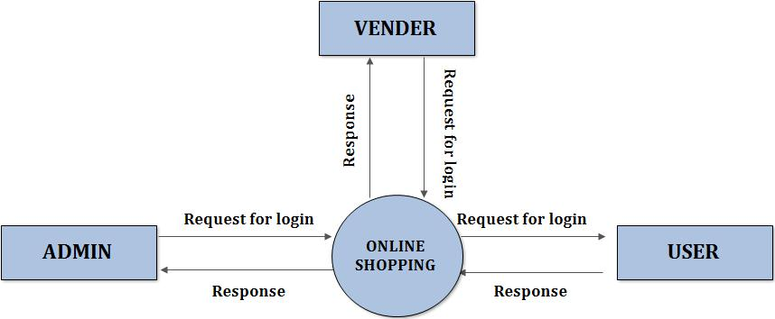
Data Flow Diagram (DFD)
Zero Level Data Flow Diagram (Context Level)

Slide 26
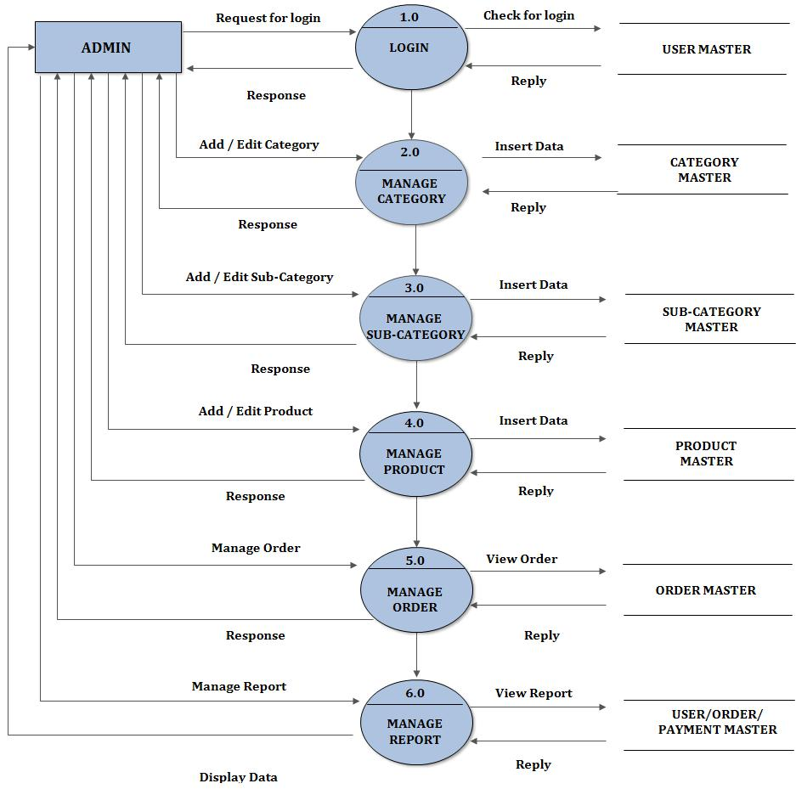
Data Flow Diagram (DFD)
First Level Admin Side Data Flow Diagram

Slide 27
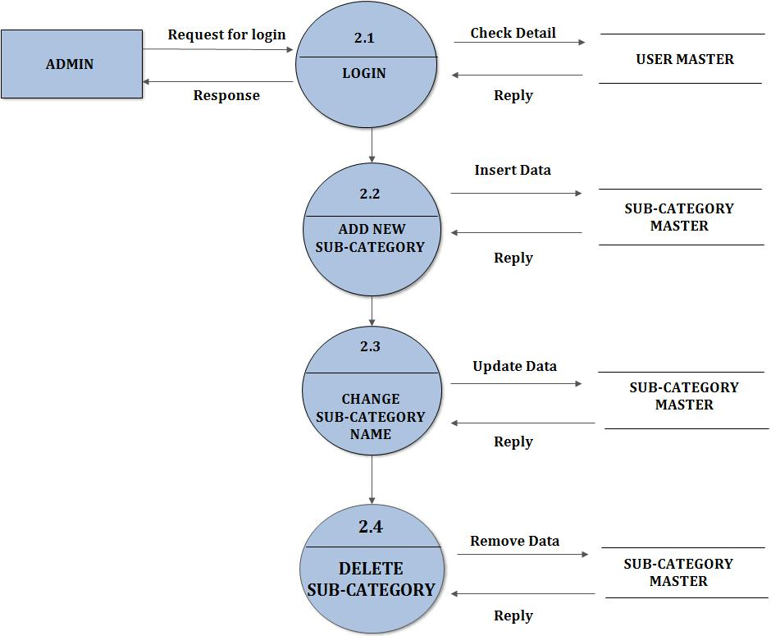
Data Flow Diagram (DFD)
Second Level Admin
Side Data Flow Diagram (2.0)

Slide 28
Data Flow Diagram (DFD)
Zero Level User Side Data Flow Diagram
USER
ORDER

Slide 29
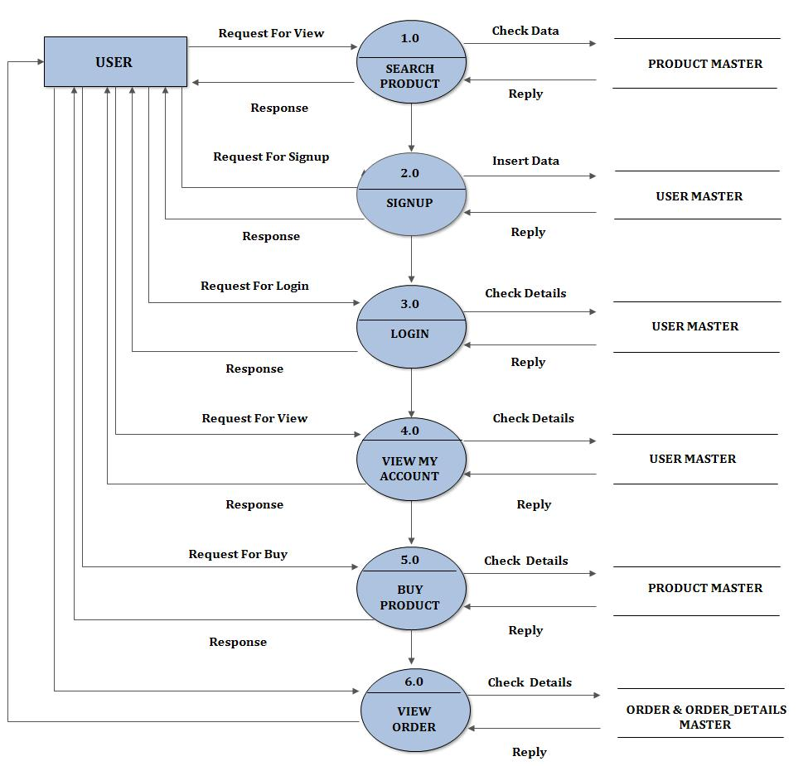
Data Flow Diagram (DFD)
First Level User Side Data Flow Diagram

Slide 30
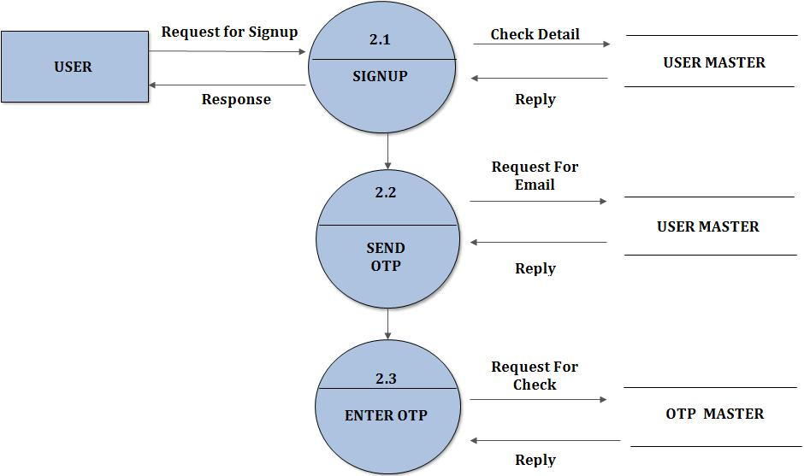
Data Flow Diagram (DFD)
Second Level User
Side Data Flow Diagram (2.0)

Slide 31
Process / Control Specification
Registration Process:
Login Process:
User info
Registration
Process Request
Email Id &
Password
Login
Provide

Slide 32
Database Directory
Product Category:
Field Name | Data Type | Size | Description
id | int | 11 | Primary Key
name | Varchar latin1_swedish_ci | 100 | Category Name
Total_product | int | 11 | Total Product in this Category

Slide 33
Database Directory
Product Sub-Category:
Field Name | Data Type | Size | Description
id | int | 11 | Primary Key
name | Varchar latin1_swedish_ci | 100 | Sub-Category Name
Cat_id | int | 100 | Category id

Slide 34
Database Directory
Product Brand:
Field Name | Data Type | Size | Description
id | int | 11 | Primary Key
name | Varchar latin1_swedish_ci | 100 | Brand Name
logo | Varchar latin1_swedish_ci | 100 | Brand Logo (image)
Total_product | int | 11 | Total Product in this Brand

Slide 35
Database Directory
Admin Table:
Field Name | Data Type | Size | Description
id | int | 11 | Primary Key
name | Varchar latin1_swedish_ci | 100 | Admin Name
gender | Varchar latin1_swedish_ci | 100 | Admin Gender
phone | bigint | 10 | Admin Mobile Number
email | Varchar latin1_swedish_ci | 11 | Admin Email
password | Varchar latin1_swedish_ci | 100 | Password
con_pass | Varchar latin1_swedish_ci | 100 | Confirm Password

Slide 36
Database Directory
Users Table:
Field Name | Data Type | Size | Description
id | int | 11 | Primary Key
name | Varchar latin1_swedish_ci | 100 | Admin Name
gender | Varchar latin1_swedish_ci | 100 | Admin Gender
phone | bigint | 10 | Admin Mobile Number
email | Varchar latin1_swedish_ci | 11 | Admin Email
password | Varchar latin1_swedish_ci | 100 | Password
con_pass | Varchar latin1_swedish_ci | 100 | Confirm Password
image | Varchar latin1_swedish_ci | 100 | User image (profile picture)
city | int | 11 | User city
address | Varchar latin1_swedish_ci | 200 | User address
lane | Varchar latin1_swedish_ci | 100 | User lane
landmark | Varchar latin1_swedish_ci | 100 | User landmark
pincode | tinyint | 6 | User address pincode
verify | tinyint | 6 | Email verification code (OTP)
status | int | 11 | User status

Slide 37
Database Directory
Product:
Field Name | Data Type | Size | Description
id | int | 11 | Primary Key
name | Varchar latin1_swedish_ci | 100 | product Name
description | Varchar latin1_swedish_ci | 100 | Product description
price | int | 11 | Product price
brand | Varchar latin1_swedish_ci | 11 | Product Brand name
cat | Varchar latin1_swedish_ci | 100 | Product category name
Sub_cat | Varchar latin1_swedish_ci | 100 | Product sub-category name
image | Varchar latin1_swedish_ci | 100 | product image
status | int | 11 | Product status

Slide 38
Database Directory
Product Cart:
Field Name | Data Type | Size | Description
id | int | 11 | Primary Key
user_id | int | 11 | User Login Id
product_id | int | 11 | Product Id (cart product)
product_qty | int | 11 | Total Product in this Cart
total_price | int | 11 | Total Price of Cart Product

Slide 39
Database Directory
Product Wish List:
Field Name | Data Type | Size | Description
id | int | 11 | Primary Key
user_id | int | 11 | User Login Id
product_id | int | 11 | Product Id (cart product)

Slide 40
Database Directory
Product Review:
Field Name | Data Type | Size | Description
id | int | 11 | Primary Key
user_id | int | 100 | User Login id
product_id | int | 11 | Product Id (product review)
rating | int | 11 | User given product rating
message | Varchar latin1_swedish_ci | 200 | User give a review for specific product

Slide 41
Database Directory
Users City:
Field Name | Data Type | Size | Description
id | int | 11 | Primary Key
name | Varchar latin1_swedish_ci | 100 | City Name
total_user | int | 11 | Total user in this city

Slide 42
Database Directory
Users Feedback:
Field Name | Data Type | Size | Description
id | int | 11 | Primary Key
user_id | int | 11 | User Login Id
comment | Varchar latin1_swedish_ci | 300 | Users send feedback

Slide 43
Database Directory
Field Name | Data Type | Size | Description
id | int | 11 | Primary Key
user_id | int | 11 | User Login Id
razorpay_payment_id | Varchar latin1_swedish_ci | 200 | Razorpay payment id get from website
amount | bigint | 20 | Order Amount
method | Varchar latin1_swedish_ci | 100 | User choose method on payment
status | Varchar latin1_swedish_ci | 100 | Payment Status
email | Varchar latin1_swedish_ci | 100 | Use user email on payment time
contact | bigint | 10 | Use user mobile number on payment time
Payment:

Slide 44
Database Directory
Order:
Field Name | Data Type | Size | Description
id | int | 11 | Primary Key
user_id | int | 11 | User Login Id
product_name | Varchar latin1_swedish_ci | 300 | All product name
quantity | int | 11 | Product quantity
price | int | 11 | Product price
Total_price | int | 11 | Total product price
Pay_type | int | 11 | User choose payment option
Order_date | date |  | User order date
status | int | 11 | Order status
Payment_id | int | 11 | Razorpay payment id

Slide 45
Database Directory
Order Cancel:
Field Name | Data Type | Size | Description
id | int | 11 | Primary Key
user_id | int | 11 | User Login Id
Order_id | int | 11 | Order id
reason | Varchar latin1_swedish_ci | 300 | Product cancel reason

Slide 46
Database Directory
Order Return:
Field Name | Data Type | Size | Description
id | int | 11 | Primary Key
user_id | int | 11 | User Login Id
Order_id | int | 11 | Order id
reason | Varchar latin1_swedish_ci | 300 | Product cancel reason

Slide 47
Database Directory
Payment Type:
Field Name | Data Type | Size | Description
id | int | 11 | Primary Key
name | Varchar latin1_swedish_ci | 100 | Payment type name

Slide 48
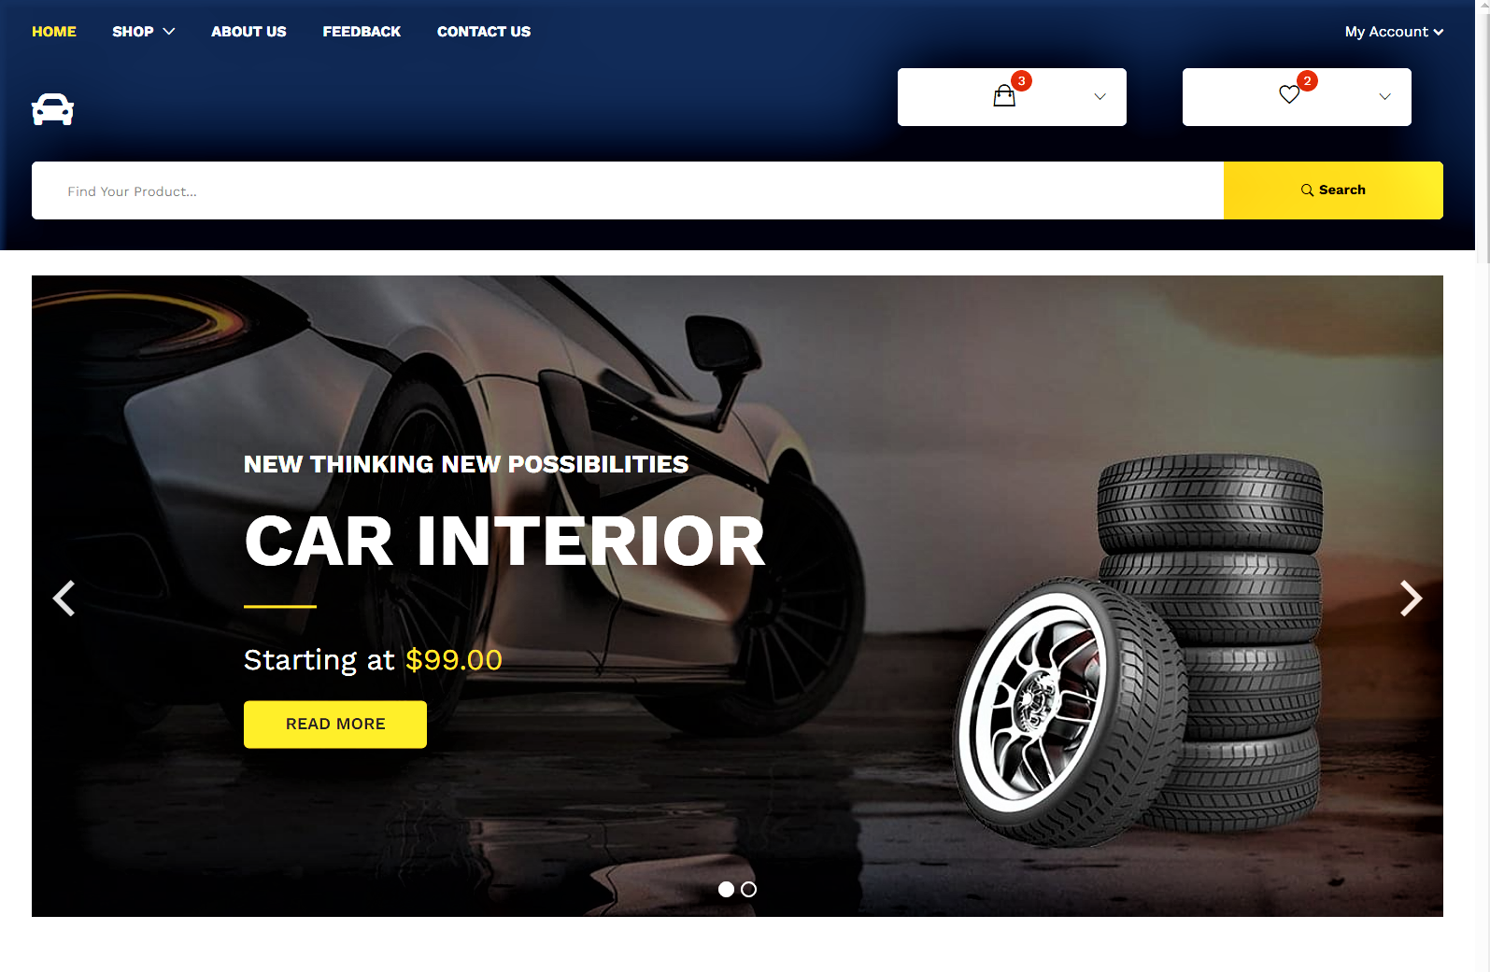
Client Side

Slide 49
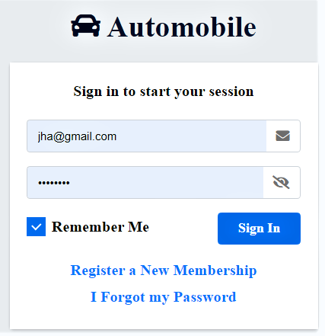
Client Login

Slide 50
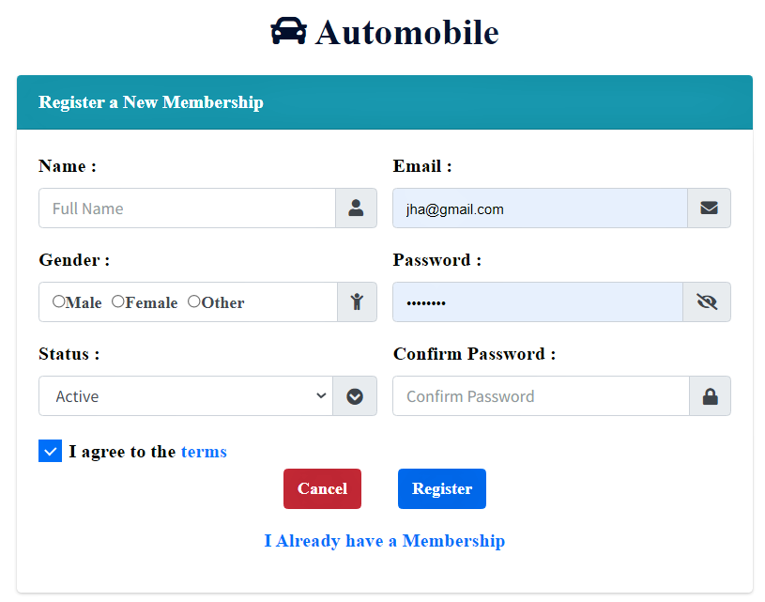
Client Registration

Slide 51
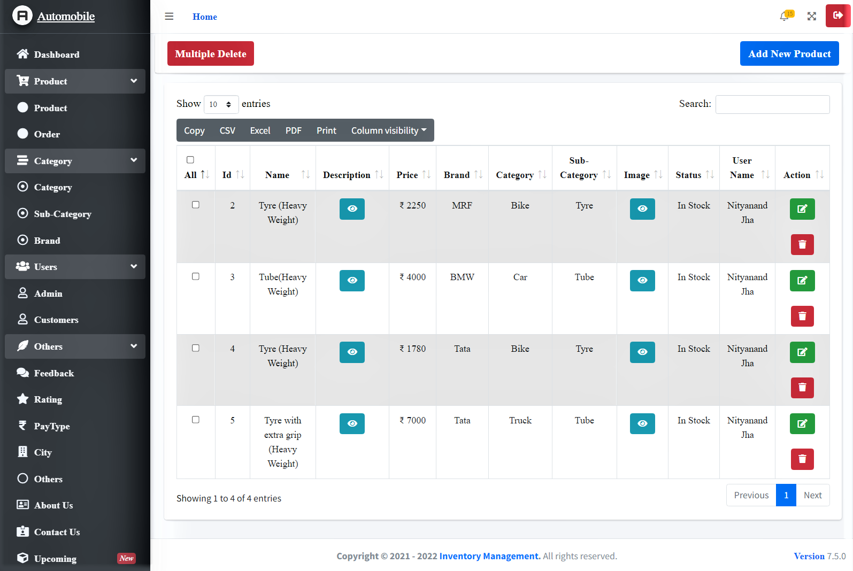
Admin Side

Slide 52
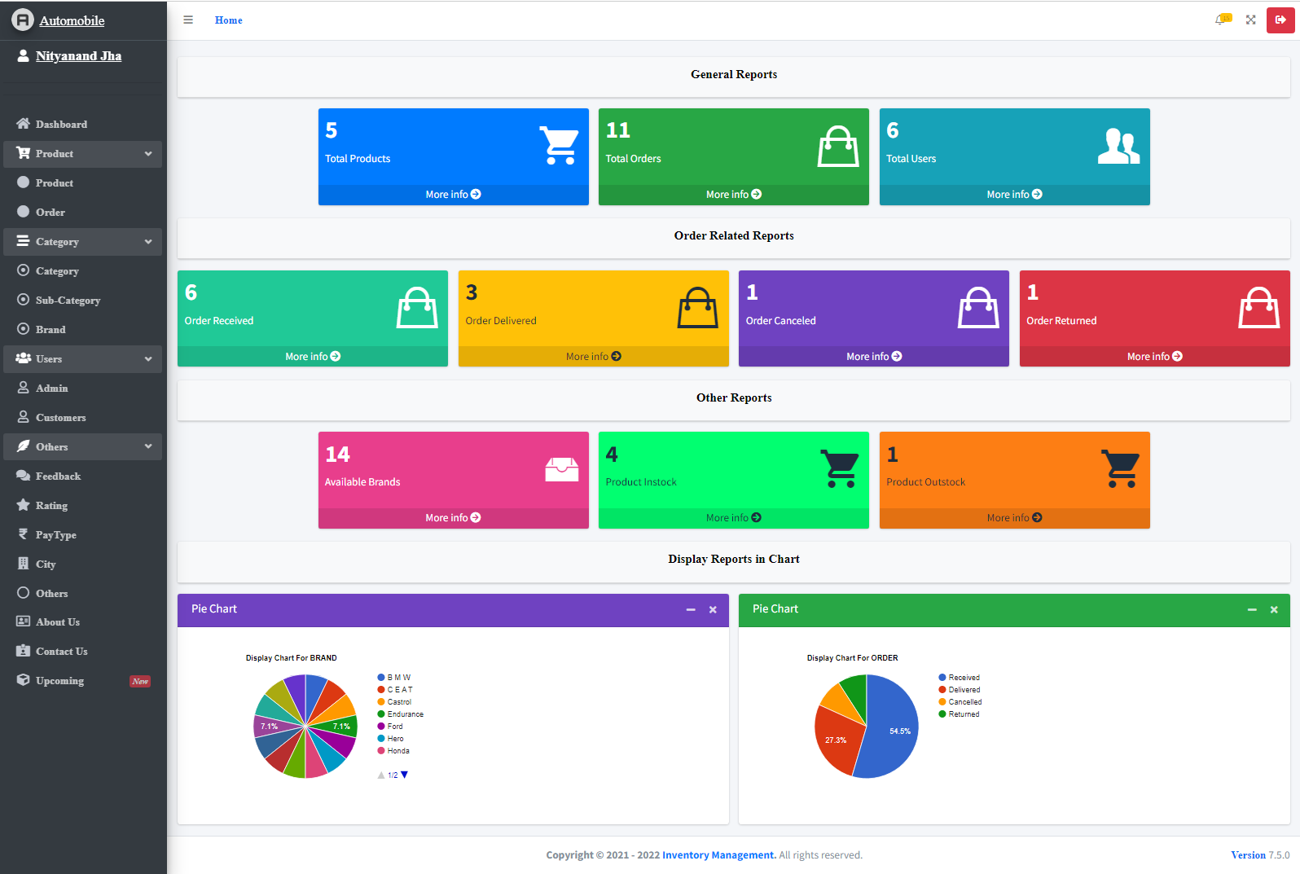

Slide 53
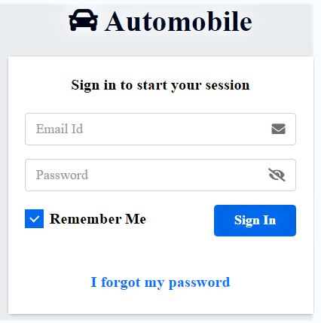
Admin Login

Slide 54
Reference
Stackoverflow :- https://stackoverflow.com/
Laravel :- https://laravel.com/
W3schools :- https://www.w3schools.in/
Font awesome :- https://fontawesome.com/
Library :- https://cdnjs.com/
Product :- https://amazon.in , https://gomechanic.in

Slide 55
CONCLUSION
In any business, make it big or small, we must understand that taking good concern of our record is very essential.
We seeing that managers do not understand the concept of good inventory management, we must learn to be familiar with it and its applications.
One or the reasons for the failure of a commerce is its inventory organization. In attendance are a lot of traditions to fight failure, and we can start from here.
There are new technologies that can help us maintain and supervise out inventory. What we can do is learn, implement and evaluate our business.

Slide 56

Thanking You

